Slide 1
…learning from Proverbs

Slide 2
…learning from Proverbs

Slide 3
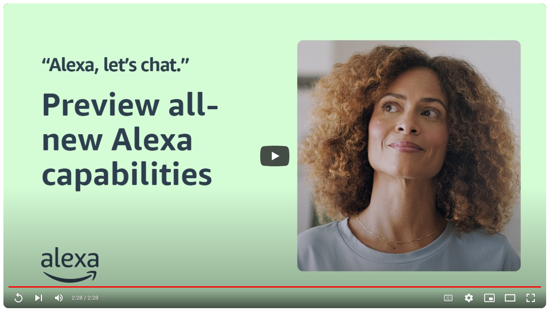

Slide 4
Proverbs 8-9 “Wisdom’s call”
Wisdom
is like a person…
Jesus is a person…
…whose help is closely available
(v1-11)
…whose benefits are incredibly valuable
(v12-21)
…whose influence is absolutely foundational
(v22-31)
?
Decision time!
(v32-36)

