Slide 1
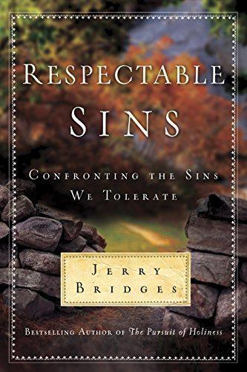

Slide 2
Exodus 16
Grumbling : A respectable sin?
It distorts the past
It exaggerates the present
It dishonours God

Slide 3
Exodus 16
Grumbling : A respectable sin?
It distorts the past, v3
It exaggerates the present, v3
It dishonours God, v2, 6-8
The Solution: Trust God
You can trust God to provide, v9-21
You can trust God enough to rest, v22-30
You can trust God now and forever, v32-36

Slide 4
Exodus 16
Grumbling? Trust God

