Slide 7
The certainty of God’s plan…
v1-4
1) God is working out his purposes through dramatic political events
census
v5-7

Slide 8
“But you, Bethlehem Ephrathah, though you are small among the clans of Judah, out of you will come for me one who will be ruler over Israel, whose origins are from of old, from ancient times.”
Micah 5:2

Slide 9
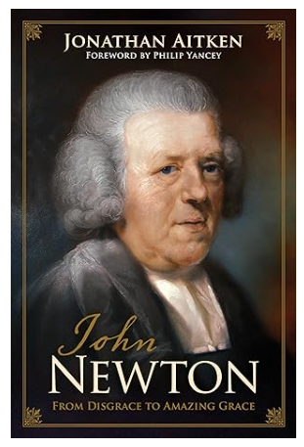
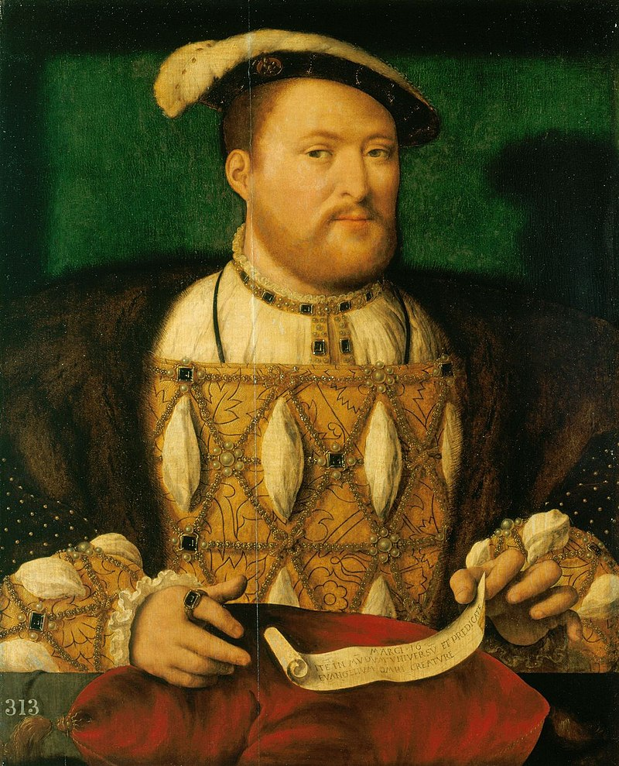
The certainty of God’s plan…
v1-4
1) God is working out his purposes through dramatic political events
census
v5-7
2) God is working out his purposes through difficult personal circumstances

